Slide 1

SALES PERFORMANCE ANALYSIS REPORT
January – December 2020

Slide 2
Action
Confidently open a new branch in an existing location or a new location to increase sales by 24% in the next 6 months.

Slide 3
Objectives
Evaluate the performance of the branches
Identify the branches with the highest sales volume
Examine the market trend and regional preference
Compare the sales performance across the branches

Slide 4
Data overview
From January 1st to December 31st , 2020. 1491 cars were sold across the six branches with an average monthly sales volume of 124.

Slide 5
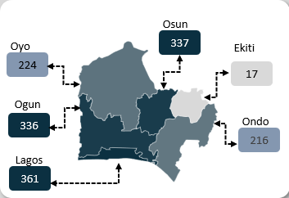
Summary facts
Lagos recorded the highest sales volume in terms of demand with 361 car sold while Ekiti had the lowest with only 17 cars sold

Slide 6
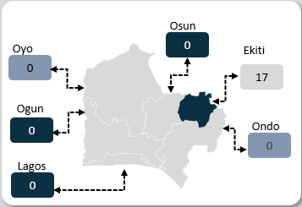
Ekiti branch facts
Sales Volume: 17 (1.14%)
Age Group: 31-35 Years (11, 65%)
Gender: Male (15, 88%)
Best Model: Rogue (7, 41%)
Best Brand: Nissan (7, 41%)

Slide 7
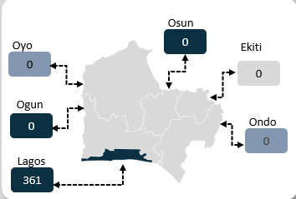
Lagos branch facts
Sales Volume: 361 (24%)
Age Group: 31-35 Years (141, 39%)
Gender: Female (272, 75%)
Best Model: Fiesta (153, 42%)
Best Brand: Ford (265, 73%)

Slide 8
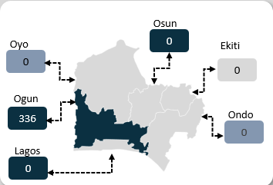
Ogun branch facts
Sales Volume: 336 (23%)
Age Group: 26-30 Years (132, 39%)
Gender: Male (271, 81%)
Best Model: Camry and Civic (115, 34%)
Best Brand: Toyota (129, 38%)

Slide 9
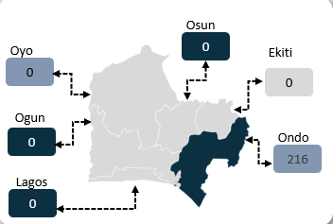
Ondo branch facts
Sales Volume: 216 (14%)
Age Group: 36-40 Years (79, 37%)
Gender: Male (147,68%)
Best Model: Rogue (143, 66%)
Best Brand: Nissan (144, 67%)

Slide 10
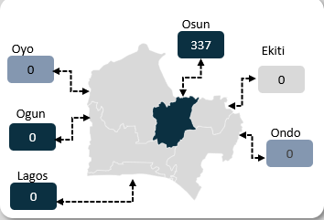
Osun branch facts
Sales Volume: 216 (23%)
Age Group: 26-30 Years (145, 67%)
Gender: Female (279,129%)
Best Model: Corolla (143, 66%)
Best Brand: Toyota (150, 69%)

Slide 11
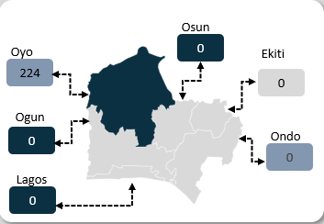
Oyo branch facts
Sales Volume: 224 (15%)
Age Group: 26-30 Years (81, 36%)
Gender: Male (145, 65%)
Best Model: Sonata (114, 51%)
Best Brand: Hyundai (115, 52%)

Slide 12
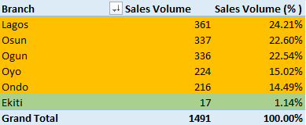
branch analysis Insight
Approximately 99% of the total sales volume came from 5 branches ( Lagos, Osun, Ogun, Oyo and Ondo).

Slide 13
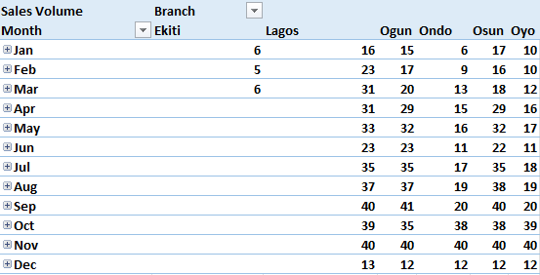
branch analysis Insight
Ekiti State has made no sales since April, and it performance over the past 3 month has been poor compared to other branches

Slide 14
branch analysis Insight
Lagos branch has the highest income level and population while Ekiti branch has the lowest income level and population.

Slide 15
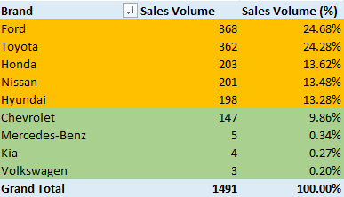
brand analysis Insight
Approximately 89% of the total sales volume came from 5 brands ( Ford, Toyota, Honda, Nissan and Hyundai.

Slide 16
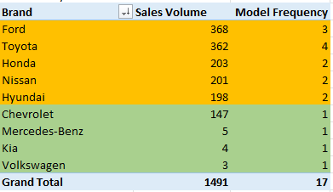
brand analysis Insight
The top 5 brands offer at least 3 models in all branches while the bottom 4 brands offer only 1 model in all branches.

Slide 17
Age analysis Insight
Average age does not have significant effect on the sales volume per branch.
The most active age group across all branches is 26 – 40 years.

Slide 18
Gender analysis Insight
There is no general effect by gender on sales volume. Gender effect is branch specific.

Slide 19
trend analysis Insight
The top 5 branches all experienced the same trend, rise in sales volume in July, August, and September and decrease in sales volume in June and December

Slide 20
recommendation
Access the feasibility of closing Ekiti Branch and relocating the resources to a higher performing branch such as Lagos Branch.
Consider opening a new branch in a high potential location like Rivers state or Abuja, which has higher income level and population.
Ensure that each branch offers at least 3 car models per brand.
Maintain consistent availability of top performing brand across all branches.

